Slide 1
Search Algorithms: Object-Oriented Implementation (Part E)

Slide 2
Contents
Conventional vs. AI Algorithms
Local Search Algorithms
Genetic Algorithm
Implementing Hill-Climbing Algorithms
Defining ‘Problem’ Class
Adding Gradient Descent
Defining ‘HillClimbing’ Class
Adding More Algorithms and Classes
Adding Genetic Algorithm
Experiments

Slide 3
Adding More Algorithms and Classes
(TODO) Add 3 new Search Algorithms to the existing code:
  random-restart
  stochastic hill climbing
  simulated annealing
(TODO) Also, modify the class structure for expandability/extensibility
  To easily add various types of algorithms
(TODO) Add configuration files
  Use a configuration file where the problem to be solved, the solution algorithm, and various parameters are predefined
  As a result, the code that interacts with the user was modified, and logic for parsing and processing the configuration file was added

Slide 4

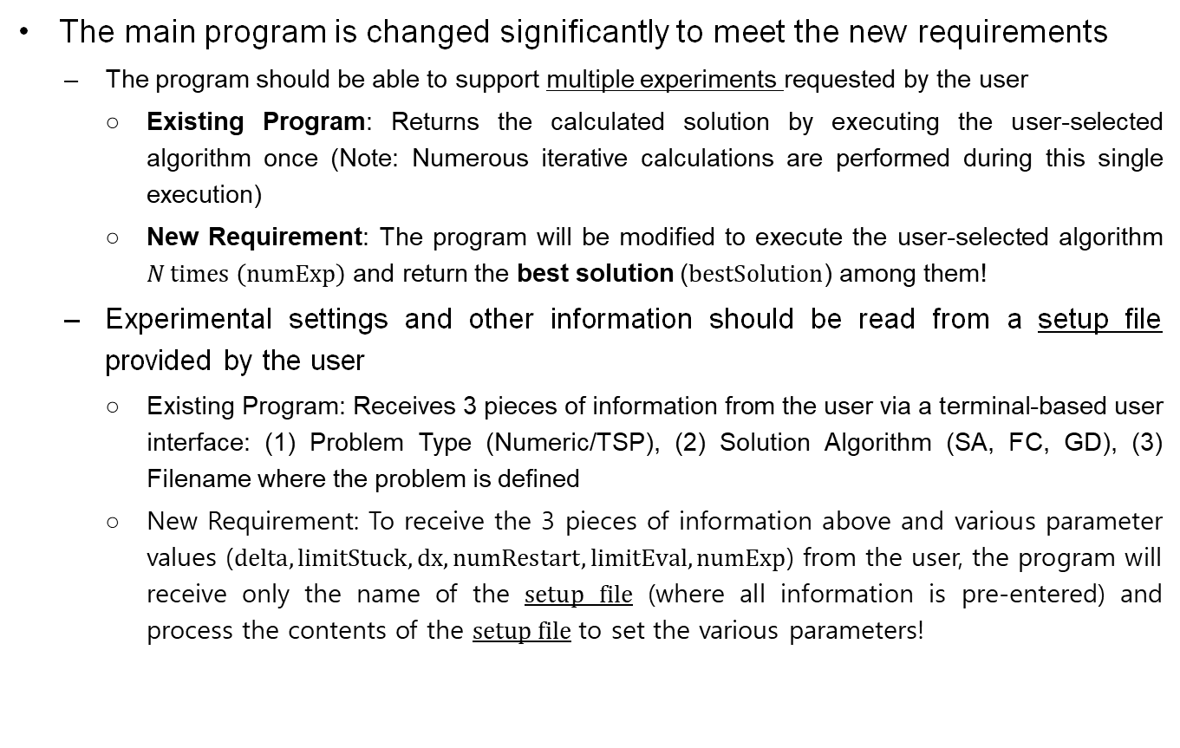
The New Main Program
The main program is changed significantly to meet the new requirements
  The program should be able to support multiple experiments requested by the user
    Existing Program: Returns the calculated solution by executing the user-selected algorithm once (Note: Numerous iterative calculations are performed during this single execution)
    New Requirement: The program will be modified to execute the user-selected algorithm $N \text{times} \left(\text{numExp}\right)$and return the best solution ($\text{bestSolution}$) among them!
  Experimental settings and other information should be read from a setup file provided by the user
    Existing Program: Receives 3 pieces of information from the user via a terminal-based user interface: (1) Problem Type (Numeric/TSP), (2) Solution Algorithm (SA, FC, GD), (3) Filename where the problem is defined
    New Requirement: To receive the 3 pieces of information above and various parameter values ($\text{delta},\text{limitStuck},\text{dx},\text{numRestart},\text{limitEval},\text{numExp}$) from the user, the program will receive only the name of the setup file (where all information is pre-entered) and process the contents of the setup file to set the various parameters!

Slide 5
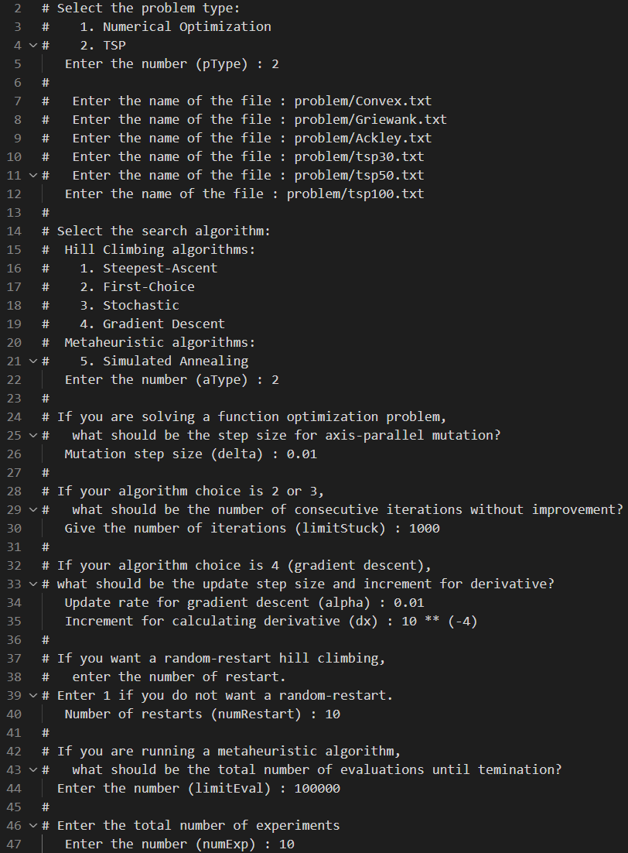
Adding More Algorithms and Classes
Modified User Interface and setup file:
  Modified User Interface: The user only enters the setup file name in the terminal
  Text File Example (Note: Lines starting with # are ignored):

Slide 6
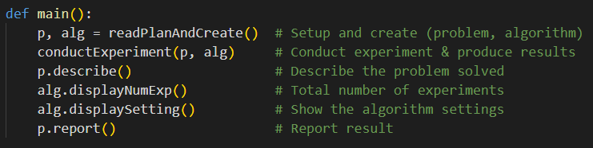
The New Main Program
main():
  (readPlanAndCreate) Reads information from a setup file and
    creates a problem p (Problem object) to be solved, and
    creates an optimizer alg (Optimizer object) to be used
  Conducts experiments and obtains the result (conductExperiment)
  Describes the problem just solved (p.describe)
  Shows the settings of experiment (alg.displayNumExp and alg.displaySetting)
  Reports the result of experiment (p.report)

Slide 7
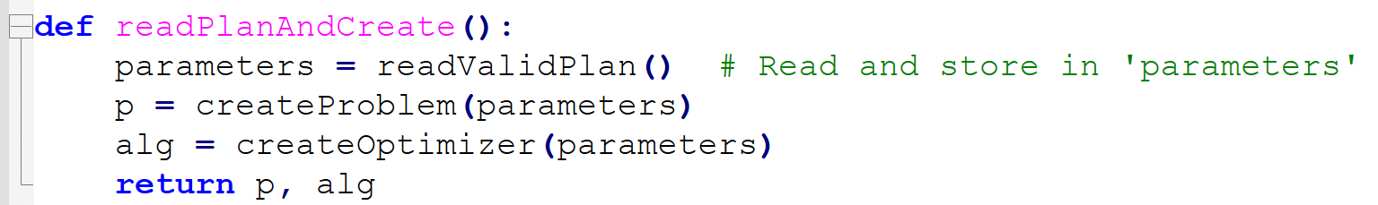
The New Main Program
readPlanAndCreate():
  Reads setup information from a file and stores them in the dictionary parameters (readValidPlan)
  Creates Problem object and store it in p (createProblem)
  Creates Optimizer object and store it in alg (createOptimizer)
  Returns p and alg

Slide 8
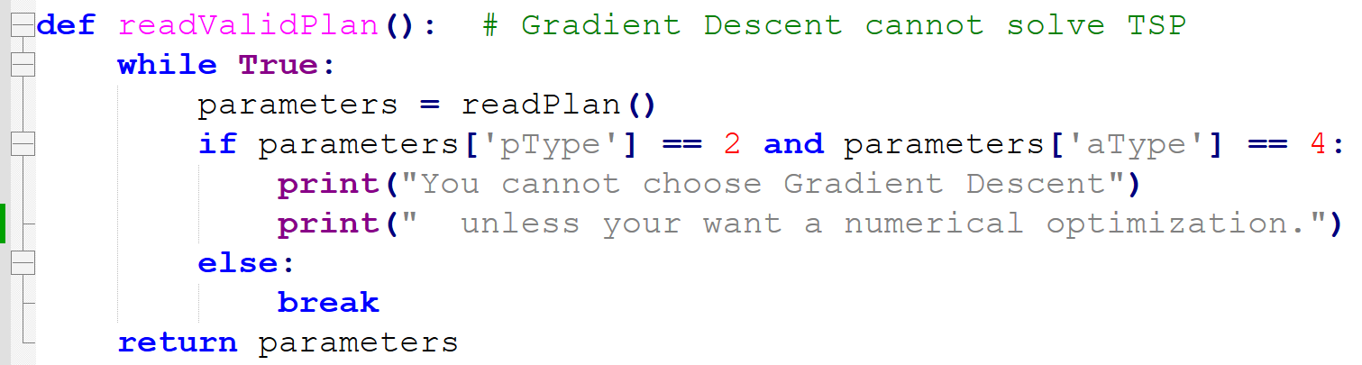
The New Main Program
readValidPlan():
  Reads setup information from a file and stores them in the dictionary parameters (readPlan)
  Keeps querying the user if gradient descent is chosen for TSP
    If the Gradient Descent solution is selected for the TSP problem (Error!), repeatedly call the readPlan function to receive a different setup file.
      TSP probem : parameters[‘pType’] = 2
      Grad Desc. algorithm : parameters[‘aType’] = 4
  Returns parameters

Slide 9

The New Main Program
readPlan():
  Obtains a file name from the user # setup 파일의 이름을 입력 받기
  Prepares a dictionary variable parameters to store the information
  Fills out parameters dictionary by reading the given setup file
    All the information are numeric values except the name of the file containing specifics of the target problem (ex: problem/Convex.txt)
    When reading the file line-by-line (lineAfterComments), lines beginning with ‘#’ are all skipped
  Returns parameters dictionary

Slide 10
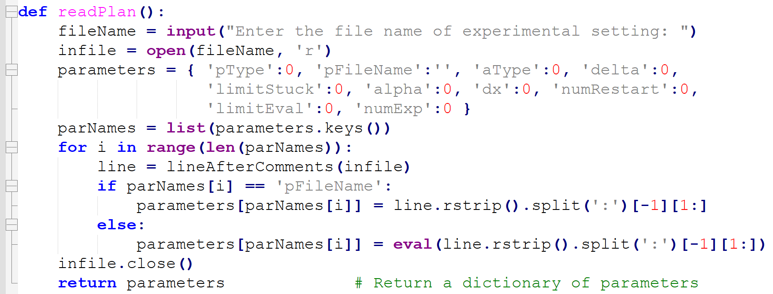
The New Main Program
readPlan():

Slide 11
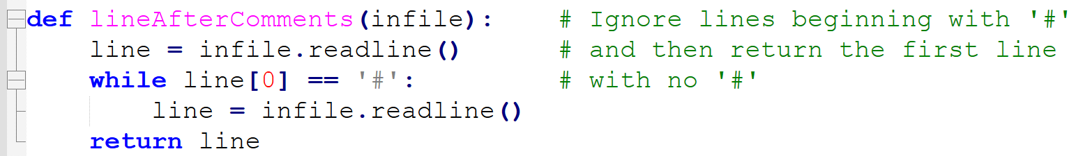
The New Main Program
lineAfterComments():
  Skips the lines beginning with the symbol ‘#’
  Returns the line that doesn’t begin with ‘#’
createProblem(parameters):
  Creates a Numeric or Tsp object and store in p depending on the type of problem chosen (i.e., parameters['pType’])
  Sets some relevant variables of p in the class hierarchy according to the values in parameters (p.setVariables)
  Returns a specific problem instance p

Slide 12
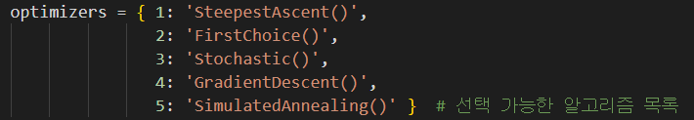
The New Main Program
createOptimizer(parameters):
  Prepares a dictionary optimizers of algorithm class names (optimizers) that can be indexed by aType (= parameters['aType'])
  Creates an object alg of the targeted algorithm by applying the eval function to the string of the name of the algorithm class (eval(optimizers[aType]))
  Sets the class variables of alg with the values in parameters (alg.setVariables)
  Returns alg as the created optimizer object

Slide 13
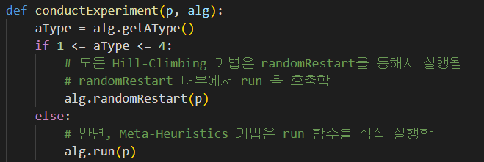
The New Main Program
conductExperiment(p, alg):
  Solves the problem p with the chosen optimizer alg and collects the result of each individual experiment
    If the chosen algorithm is a hill climber, then the random restart algorithm is called (alg.randomRestart)
    Otherwise, its run method is called (alg.run)
  Repeats experiment multiple times (numExp = parameters[numExp]) if requested and collects the results
  Finally, stores the summary of the best result (p.storeExpResult)

Slide 14
Changes to ‘Problem’ Class
For recording the results of experiments, the Problem class is revised to have the following additional variables:
  pFileName: name of the file containing problem specifics
  The following 6 values are calculated in the main.py by conductExperiment며and are stored in the problem instance by calling p.storeExpResult
  bestSolution: The best solution found so far
    best solution found in n different experiments (n = numExp = parameters[numExp])
  bestMinimum: objective value of bestSolution
  avgMinimum: average objective value of the best solutions obtained from n experiments (sumOfMinimum average)
    sumOfMinimum: Calculated in main.py, where the objective value obtained during each iteration over numExp is called newMinimum, and sumOfMinimum += newMinimum
  avgNumEval: average number of evaluations made in n different experiments
  sumOfNumEval: total number of evaluations made all through n experiments
  avgWhen:
    average iteration when the best solution first appears in n experiments
    A meaningful value only in MetaHeuristics-based algorithms
    sumOfWhen += alg.getWhenBestFound(), and avgWhen is the average value of sumOfWhen

Slide 15

Changes to ‘Problem’ Class
Accordingly, several new methods are added to handle those variables
  Three new accessors getSolution, getValue, getNumEval are necessary for conductExperiment of the main program to conduct multiple experiments
  The new method storeExpResult is also necessary for conductExperiment to store the result of experiment after finishing all the experiments
Part of conductExperiment function in main.py

Slide 16
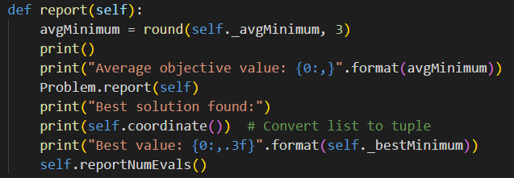
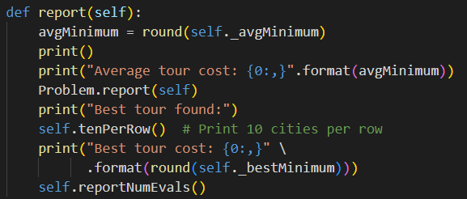
Changes to ‘Problem’ Class
The report method has been revised to display the summary result of multiple experiments in an organized fashion
  report in the base class prints messages that are common to both numerical optimization problem and TSP
  Those in the subclasses print messages specific to the type of problem just solved
  Therefore, the report methods in the Numeric and TSP classes call the report method of the parent class (Problem.report(self)) and then print their respective specialized information.
report method from Numeric
report method from TSP
Refer to the next page

Slide 17
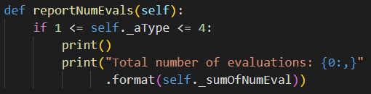
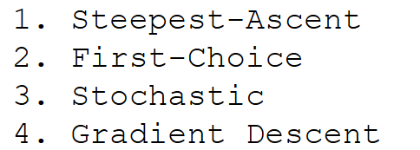
Changes to ‘Problem’ Class
The reportNumEvals method prints out the total number of evaluations regardless of the problem type
  However, it does nothing when the algorithm used is MetaHeuristics (simulated annealing or GA) because the number of evaluations for them is predetermined
  It is separated from report because we want the result messages printed out in some appropriate order when they are mixed together with the messages generated from the subclasses
  Call to reportNumEvals is made within report of the subclasses at its last line (Referring to the previous page)

Slide 18
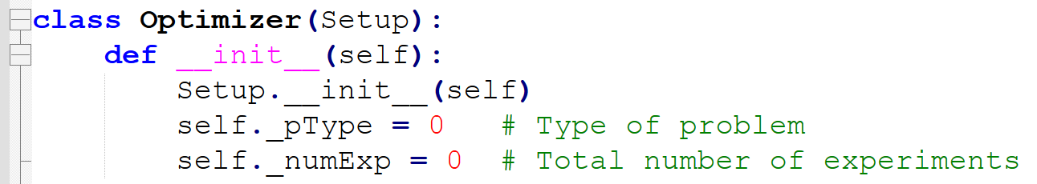
‘Optimizer’ Class
Optimizer has two variables pType and numExp to store common information about experimental settings:
  The methods in the class hierarchy of Optimizer are extended versions of those previously existed in HillClimbing
  New accessor methods getWhenBestFound (in MetaHeuristics) and getNumExp (in Optimizer) are added for being used by the conductExperiment function in the main program
Both ‘random.py’ and ‘math.py’ should be imported to the ‘optimizer.py’ file
  the methods for stochastic hill climbing and simulated annealing algorithms need them

Slide 19
‘Optimizer’ Class
HillClimbing now has only two variables: limitStuck and numRestart
  pType has moved up to optimizer
MetaHeuristics is a parent of SimulatedAnnealing and GA
  MetaHeuristics has two variables: limitEval and whenBestFound
  displaySettings method prints out limitEval (total number of evaluations until termination)
HillClimbing
MetaHeuristics
limitStuck
numRestart
limitEval
whenBestFound
__init__
setVariables
displaySetting
randomRestart
__init__
setVariables
getWhenBestFound
displaySetting

Slide 20
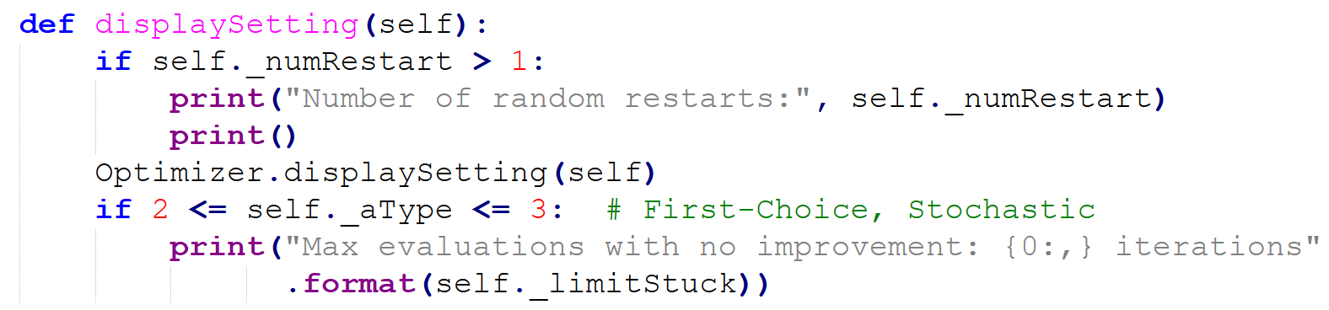
Changes to ‘HillClimbing’ Class
Changes of variables:
  Under the new Optimizer class hierarchy, the variable pType is moved up from HillClimbing to Optimizer
  A variable numRestart is newly added (the setVariables method is revised accordingly)
Changes to the displaySetting method:
  The printing of mutation step size is moved up to Optimizer
  Now it prints out setting information related only to the variables of its own class HillClimbing

Slide 21
Adding three search algorithm
(TO-DO) Add 3 new Search Algorithms to the existing code :
  HillClimbing > Stochastic(stochastic hill climbing) and randomRestart, then MetaHeuristics > SimulatedAnnealing
  Note that randomRestart is not implemented as a separate class but as a method within the HillClimbing class.
Optimizer
HillClimbing
MetaHeuristics
randomRestart
SimulatedAnnealing
Implemented as HillClimbing class method
SteepestAscent
NEW
GA
FirstChoice
Stochastic
NEW
GradientDescent

Slide 22
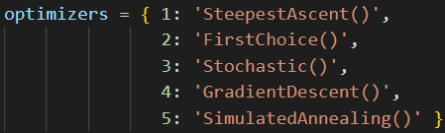
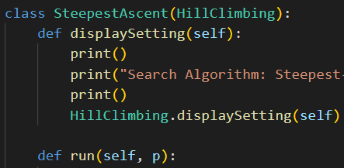
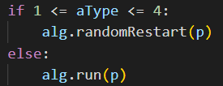
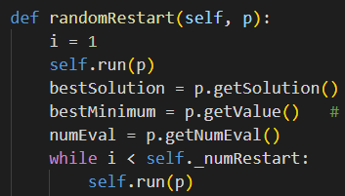
Changes to ‘HillClimbing’ Class for randomRestart
A new method randomRestart is added to HillClimbing class
  It keeps calling self.run for a given number of times (self._numRestart), and stores the best solution found (p.storeResult(bestSolution, bestMinimum))
  HillClimbing overall call sequence:
    Note: MetaHeuristics do not use the randomRestart method
HillClimbing Class
In alg=SteepestAscent(), run method under SteepestAscent class is extecuted
from conduct Experiment function in main.py..

Slide 23
Stochastic Hill Climbing (Stochastic Class)
The algorithm of stochastic hill climbing is the same as first-choice hill climbing except the way a successor is chosen
  First-choice hill climbing generates a single successor randomly
  Stochastic hill climbing generates multiple neighbors and then selects one from them at random by a probability proportional to the solution quality
  The algorithm is implemented as the run method as before
<SteepestDescent run method>
Generate 2N neighbor solutions and select the single best solution using the bestOf function,
Compare with current solution
Choose if better; otherwise terminate
<Stochastic run method>
Generate 2N neighbor solutions
Select one randomly using the stochasticBest,
compare with current solution
  Choose if better,
  Otherwise, terminate if self._limitStuck consecutive bad solutions are encountered
<First-Choice run method>
Randomly generate 1 neighbor solution,
compare with current solution
  Choose if better,
  Otherwise, terminate if self._limitStuck consecutive bad solutions are encountered
CAUTION!! The actual implementation proceeds this way (like First-Choice, by selecting only solutions better than the current one). This is because, in this lecture, HillClimbing is assumed to be a category that includes techniques that only advance toward a better side...

Slide 24
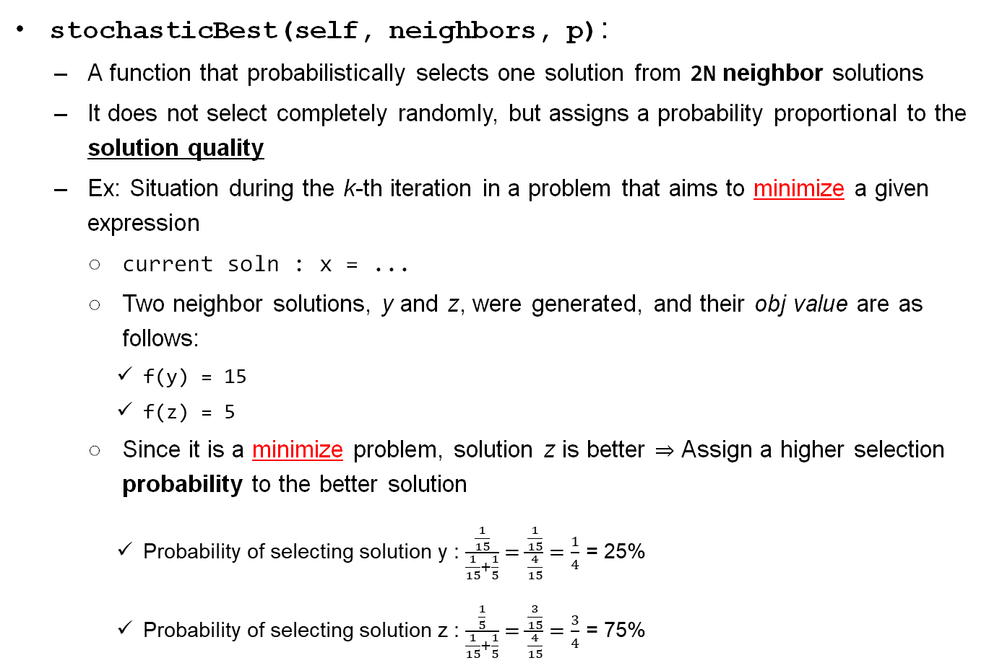
Stochastic Hill Climbing (Stochastic Class)
stochasticBest(self, neighbors, p):
  A function that probabilistically selects one solution from 2N neighbor solutions
  It does not select completely randomly, but assigns a probability proportional to the solution quality
  Ex: Situation during the k-th iteration in a problem that aims to minimize a given expression
    current soln : x = ...
    Two neighbor solutions, y and z, were generated, and their obj value are as follows:
      f(y) = 15
      f(z) = 5
    Since it is a minimize problem, solution z is better $⇒$ Assign a higher selection probability to the better solution
      Probability of selecting solution y : $\frac{\frac{1}{15}}{\frac{1}{15}+\frac{1}{5}}=\frac{\frac{1}{15}}{\frac{4}{15}}=\frac{1}{4}$ = 25%
      Probability of selecting solution z : $\frac{\frac{1}{5}}{\frac{1}{15}+\frac{1}{5}}=\frac{\frac{3}{15}}{\frac{4}{15}}=\frac{3}{4}$ = 75%

Slide 25
Stochastic Hill Climbing (Stochastic Class)
stochasticBest(self, neighbors, p):
  Probabilistic selection: How to select y with 0.25 probability and z with 0.75 probability??
  [1] Use a probability value between 0 and 1 to search sequentially}
    Generate a random value between [0, 1] and store it in r
    If the value of r is less than (or equal to) 0.25, select y; otherwise, select z
  [2] Use the numpy library
    my_choice = np.random.choice(a=[x,y], p=[0.25,0.75])
    Note : numpy random documentation
  however, ...
    If f(y)=1 and f(z)=-1, the denominator becomes 0 (divide-by-zero.)
    Depending on the situation, a negative probability might result.
    What is the implementation method that considers general situations? (Next page)

Slide 26

Stochastic Hill Climbing (Stochastic Class)
stochasticBest(self, neighbors, p):
  Implementation method considering the general situation:
  Obtains a list of evaluation values of neighbors and store in valuesForMin
    (Original problem) Smaller values are better
    However, to make the probability-based selection calculation easier, the following operation is performed
  Converts the list to the one in which larger values are better (valuesForMax)
    Changes the values so that the larger the value, the higher the selection probability
    Each original value is subtracted from a large enough value
    (ex. max(valuesForMin)+1 to avoid zero)
    The converted values are stored in the valuesForMax list
  Chooses at random from valuesForMax with probability proportional to its value
  Returns the chosen neighbor together with
  its original evaluation value
0
r
total
예) 9 solutions were made, and $v_{0}$ to $v_{8}$ are the valuesForMax. A value is drawn randomly from the list. After generating a random number r within [0, $\text{sum}\left(\text{valuesForMax}\right))$, one solution is selected along with its index, like in the example
v₀
v₁
v₂
v₃
v₄
v₅
v₇
v₈

Slide 27
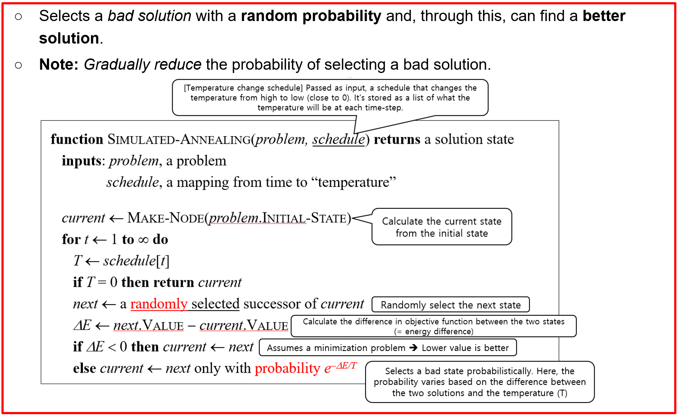
Simulated Annealing (SimulatedAnnealing Class)
Working Principle
  Generates one next solution randomly
  (just like first-choice)
  Selects the next solution if it is better
  than the current solution.
  Selects the next solution probabilistically
  even if it is worse than the current solution.
    Uses the probability exp(–dE/t)
    for selection
Additional Member Variable: There is one variable numSample storing the number of samples used to heuristically determine an initial temperature (초기 온도값)
  It is currently preset to 100 (in SimulatedAnnealing Class)
  Used in initTemp function (See next slide)
  Used to generate the initial temperature value.

Slide 28
Simulated Annealing (SimulatedAnnealing Class)
initTemp(self, p):
  Working method
    Calculates the temperature t such that exp(–dE/t) = 0.5, and returns t
    That is, it finds the temperature t where the probability of selecting a bad solution is 0.5 and returns it.
    Why? It is reasonable to use a t that satisfies the above condition as the initial temperature.
  Implementation
    Takes k (= self._numSample) random samples and their neighbors from the domain of problem p
    The process of generating an arbitrary initial value, randomly generating its neighboring solution, recording the difference, and calculating the average difference value is repeated k times.
    Calculates the average difference between two solutions (= dE average value)
    Sets the initial t value using the calculated average value of dE such that the probability of selecting a bad solution is 0.5 initially.

Slide 29
Simulated Annealing (SimulatedAnnealing Class)
initTemp(self, p):
  Working method
    Calculates the temperature t such that exp(–dE/t) = 0.5, and returns t
    That is, it finds the temperature t where the probability of selecting a bad solution is 0.5 and returns it.
  Implementation
    Implemented as following:
      For m-th iteration in range(self._numSample):
        generate a random initial solution and evaluate (= v0)
        generate a random mutation and evaluate (= v1)
        calc diffs(m) = abs(v1-v0)
      Calculates the average dE of their differences
        dE = sum( diffs ) / self._numSample
      return t = dE / math.log(2) # Initial Temperature Setting. Why is it this way? (Next Page)

Slide 30
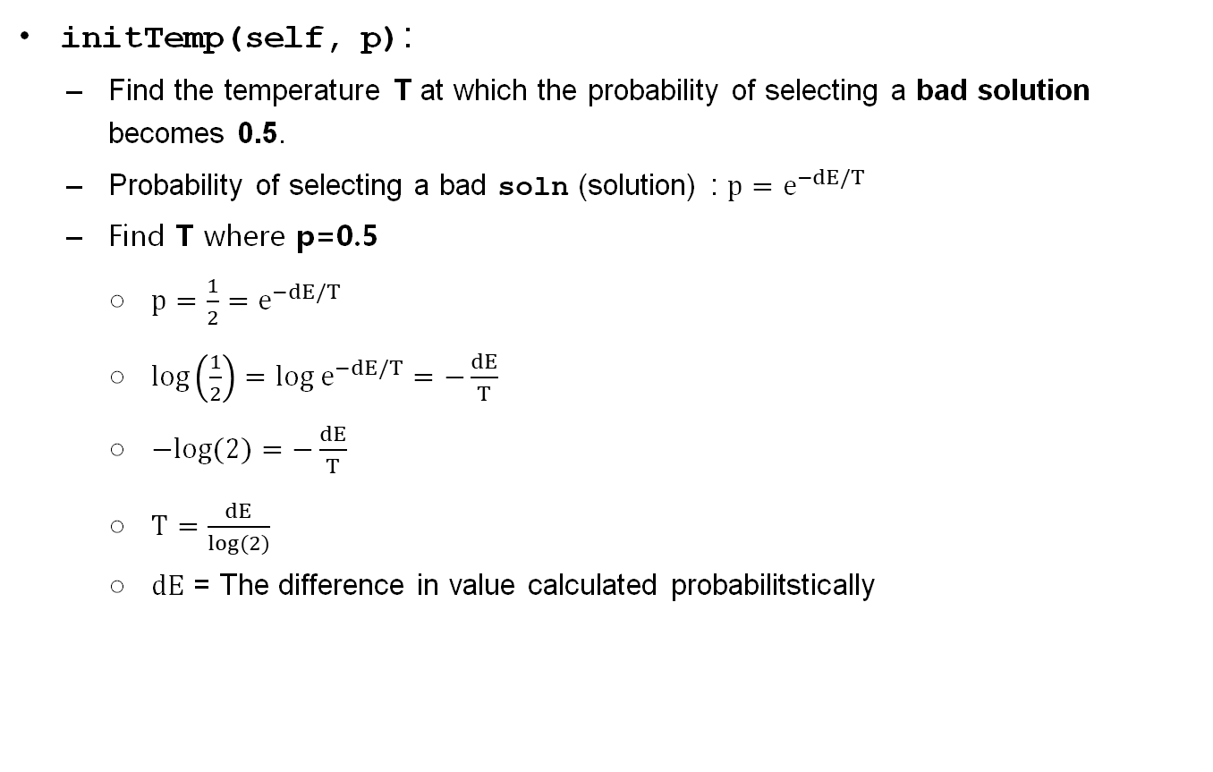
Simulated Annealing (SimulatedAnnealing Class)
initTemp(self, p):
  Find the temperature T at which the probability of selecting a bad solution becomes 0.5.
  Probability of selecting a bad soln (solution) : $p=e^{−dE/T}$
  Find T where p=0.5
    $p=\frac{1}{2}=e^{−dE/T}$
    $log\left(\frac{1}{2}\right)=log e^{−dE/T}=−\frac{dE}{T}$
    $−log(2)=−\frac{dE}{T}$
    $T=\frac{dE}{log(2)}$
    $dE$ = The difference in value calculated probabilitstically

Slide 31
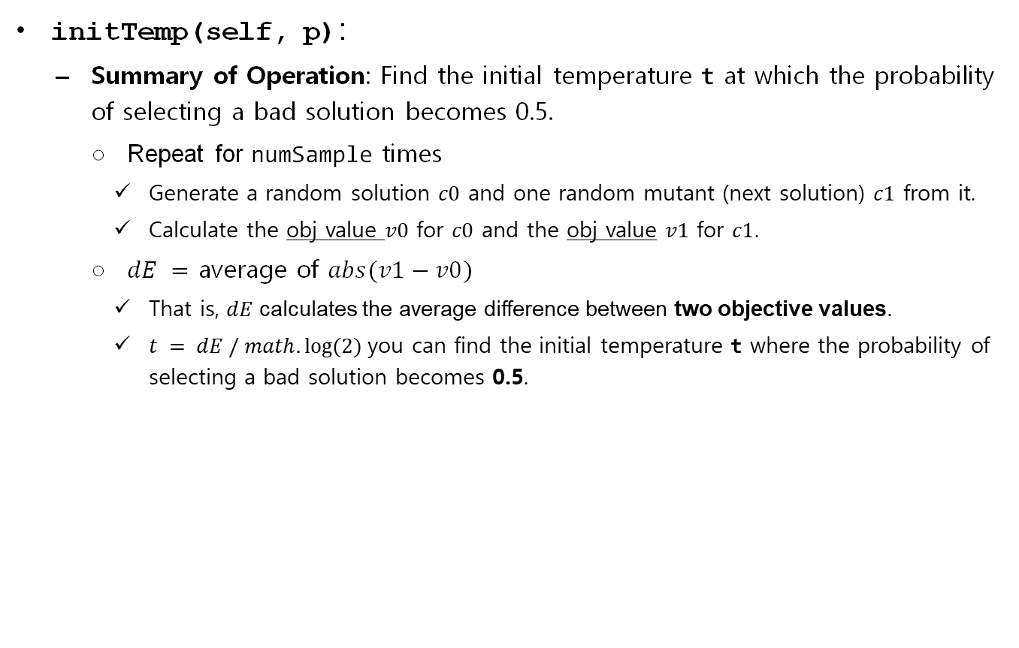
Simulated Annealing (SimulatedAnnealing Class)
initTemp(self, p):
  Summary of Operation: Find the initial temperature t at which the probability of selecting a bad solution becomes 0.5.
    Repeat for numSample times
      Generate a random solution $c0$ and one random mutant (next solution) $c1$ from it.
      Calculate the obj value $v0$ for $c0$ and the obj value $v1$ for $c1$.
    $dE =$ average of $abs(v1−v0)$
      That is, $dE$ calculates the average difference between two objective values.
      $t = dE / math.log⁡(2)$you can find the initial temperature t where the probability of selecting a bad solution becomes 0.5.

Slide 32

Simulated Annealing (SimulatedAnnealing Class)
tSchedule(self, t):
  Calculates the next temperature using a simple formula, and returns it
  The temperature schedule values can be used in the form of a pre-calculated list (array), or it can be implemented, as shown above, to take the current temperature as input and calculate the next temperature.

Slide 33
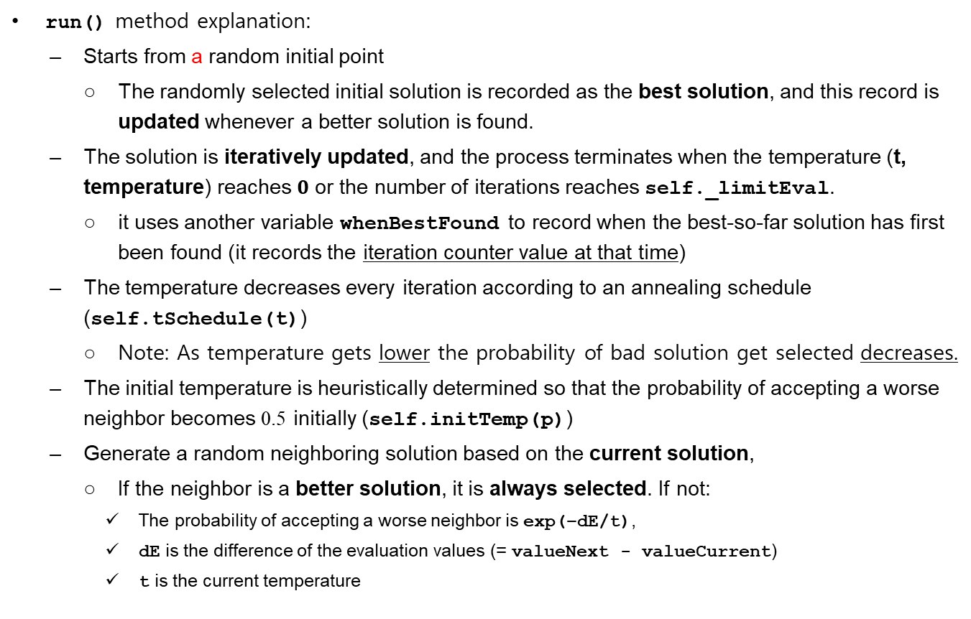
Simulated Annealing (SimulatedAnnealing Class)
run() method explanation:
  Starts from a random initial point
    The randomly selected initial solution is recorded as the best solution, and this record is updated whenever a better solution is found.
  The solution is iteratively updated, and the process terminates when the temperature (t, temperature) reaches $0$ or the number of iterations reaches self._limitEval.
    it uses another variable whenBestFound to record when the best-so-far solution has first been found (it records the iteration counter value at that time)
  The temperature decreases every iteration according to an annealing schedule (self.tSchedule(t))
    Note: As temperature gets lower the probability of bad solution get selected decreases.
  The initial temperature is heuristically determined so that the probability of accepting a worse neighbor becomes 0.5 initially (self.initTemp(p))
  Generate a random neighboring solution based on the current solution,
    If the neighbor is a better solution, it is always selected. If not:
      The probability of accepting a worse neighbor is exp(–dE/t),
      dE is the difference of the evaluation values (= valueNext - valueCurrent)
      t is the current temperature

